Slide 1
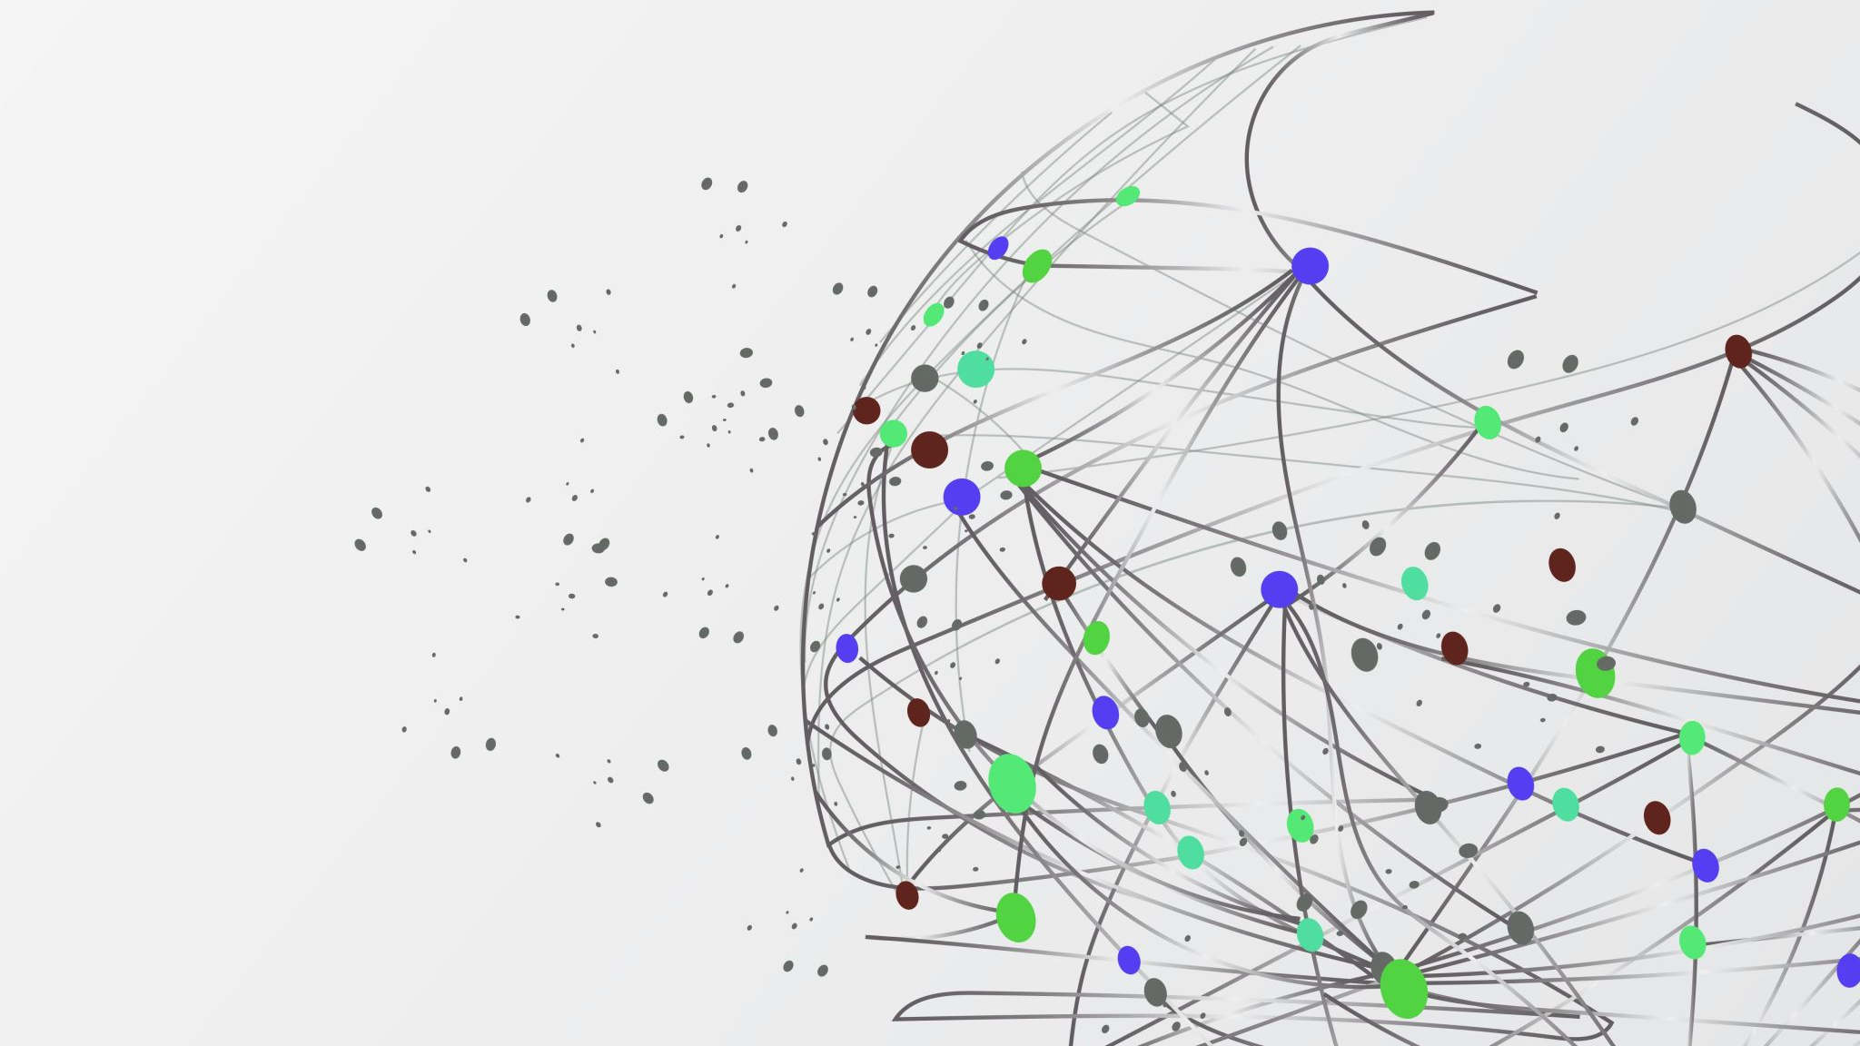
DePaul University International Applications:
Improving Admissions and Outreach Strategies
Team 10

Slide 2
Introduction
This project analyzes international student application data from DePaul University
The aim is to identify recruitment patterns, program demand, and application outcomes
Data analytics techniques were applied to support strategic admissions decision-making

Slide 3

Overview of the Dataset
The Dataset contains:
7,543 international application records
80 variables describing applicant and application details
Covers multiple intake periods, mainly Fall 2024 and Fall 2025
Represents applicants from diverse international backgrounds
Data collected from admissions and recruitment systems

Slide 4

Dataset Composition
Outreach and communication records
Application processing information
Campaign management data
Academic program selection
Personal and demographic information
Immigration and post-admission indicators

Slide 5
Geographic Scope
Applicants originate from 95 unique countries
Demonstrates strong international diversity
Some records contain missing geographic information
Emphasizes the need for geographic data validation

Slide 6
Tools & Methodology
Tools:
Excel & Power Query
Power Pivot
Looker Studio
Google Sheets
Methodology:
Data Cleaning: Removed duplicates, null columns, and standardized values (7,543 to 5,000 records)
Analysis: Examined geographic, program, college, temporal, and channel patterns
Dashboard Design: Built KPIs and visualizations answering strategic questions

Slide 7
Data Quality Assessment
The following data quality issues were identified in the DePaul Dataset:
38 variables contained 100% missing values, making them unusable for analysis.
Duplicate columns, rows and system-generated timestamp fields were identified.
Inconsistencies existed in country and program naming.
Placeholder values appeared in text-based fields.
Duplicate application records.

Slide 8
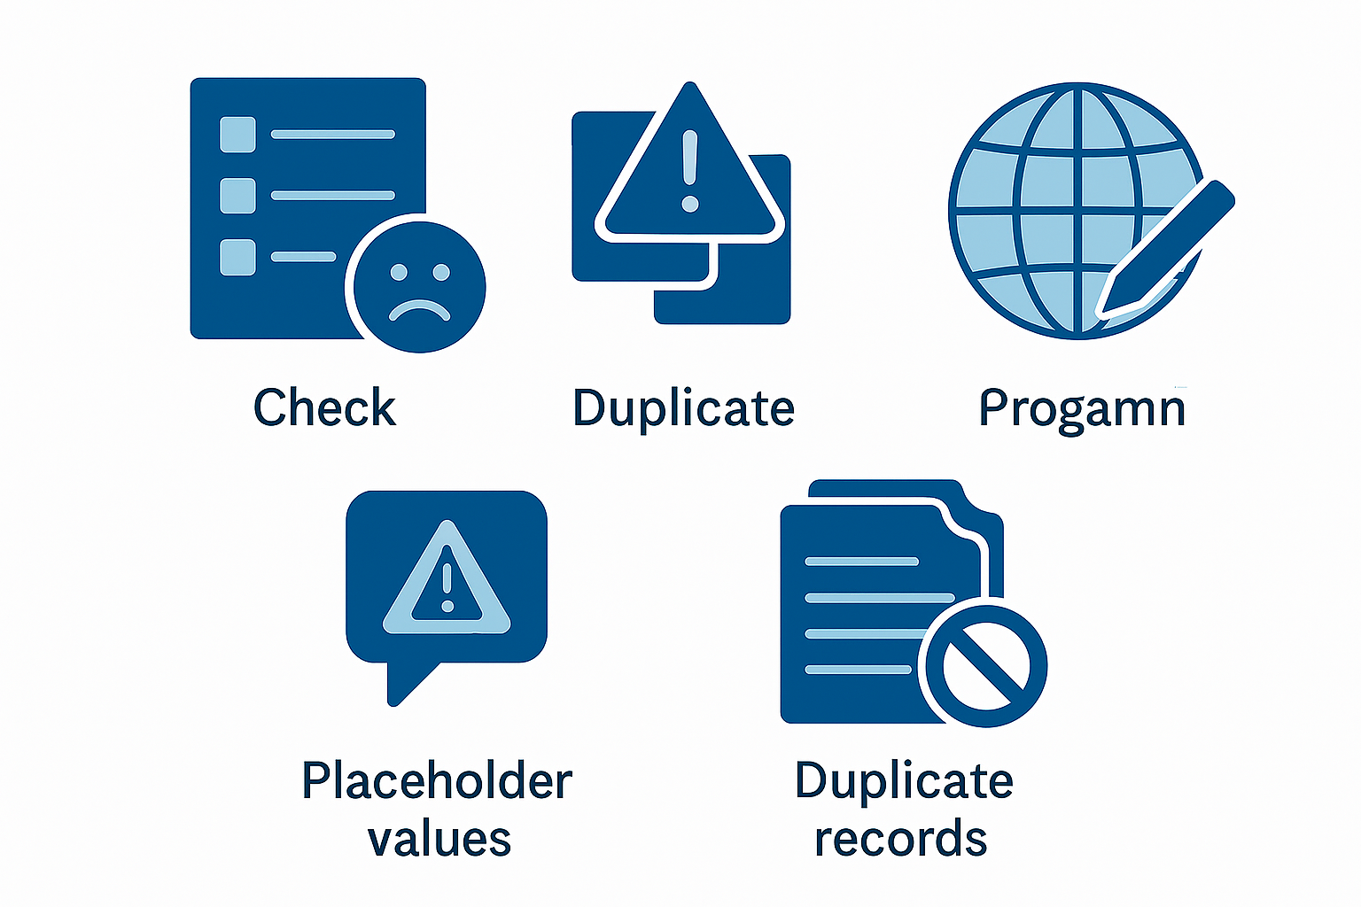
Data Preparation and Cleaning
A systematic data cleaning process was undertaken to improve data quality and analytical reliability:
100% NULL columns were removed.
Duplicate records were removed.
Columns irrelevant to analysis were removed (e.g., email, phone number, etc.)
Country and program names were standardized, and spelling inconsistencies were resolved.
Desired Program and Admission flag columns created.
Placeholders and NULLs in the name columns were resolved.
Admit_date column was standardized, and NULL rows were left as such for pending admissions.

Slide 9
Impact of Data Cleaning
Dataset | Rows | Columns
Original Dataset | 7543 | 80
Cleaned Dataset | 5000 | 10
Stage | Columns Remaining
Original Dataset | 80
After Null Removal | 42
After Duplicate and Irrelevant Removal | 10

Slide 10
Dashboard Development
An interactive dashboard titled “DePaul University Applications Tracker Dashboard” was developed using Google Looker Studio to visualize and present key admissions and recruitment metrics.
Supports filtering by application source and admission year
Enables real-time monitoring of application trends

Slide 11
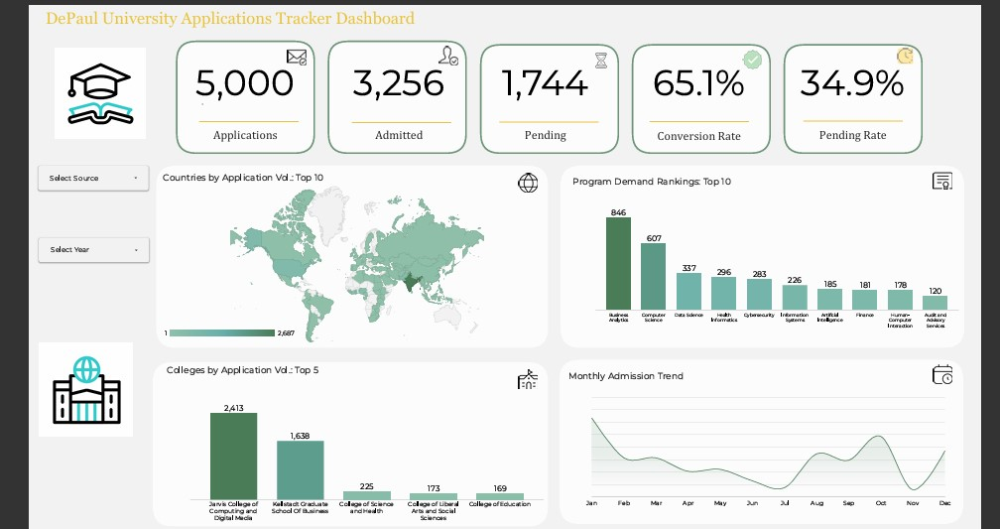

Slide 12
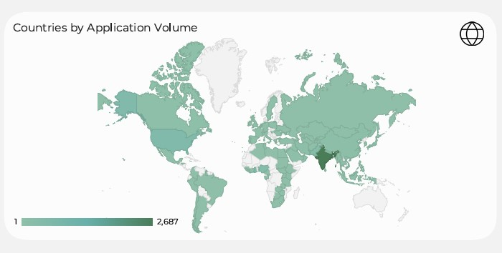
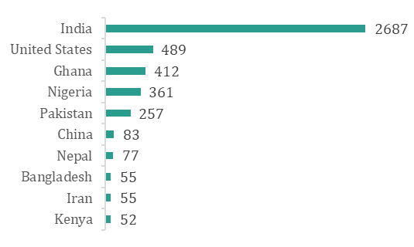
Where Are Our Applicants Coming From?
India dominates the applicant pool with 2,687 applications (53.7%).
USA follows closely (489), West Africa shows promise with Ghana (412) and Nigeria (361) collectively contributing 15.5%.

Slide 13
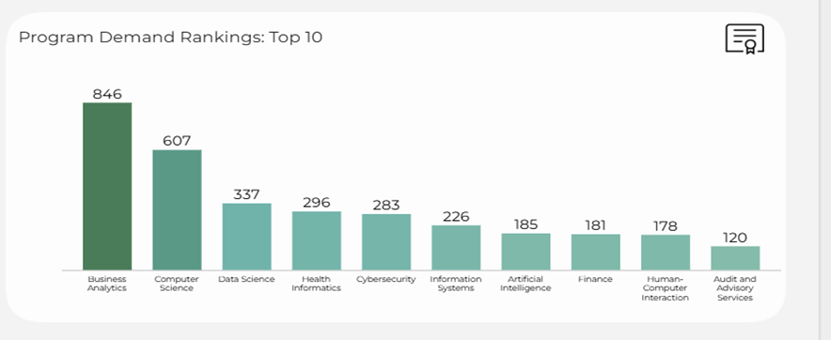
Which Programs Drive Demand?
Business Analytics leads with 846 applications, followed by Computer Science and Data Science.
Nine of the top 10 programs are STEM fields, collectively representing 42.3% of all applications.

Slide 14
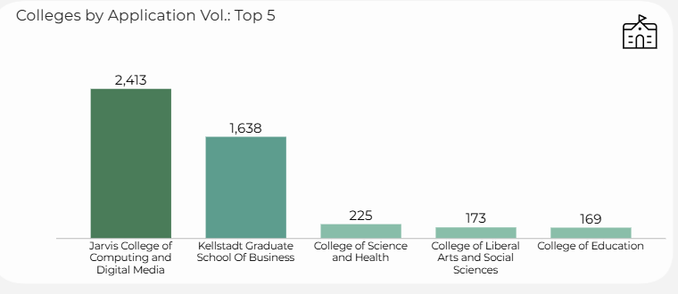
Which College Has the Highest Applications?
Jarvis College of Computing and Digital Media (2,413) and Kellstadt Graduate School of Business (1,638) together capture 81.1% of international applications.
The remaining colleges average fewer than 225 applications each.

Slide 15
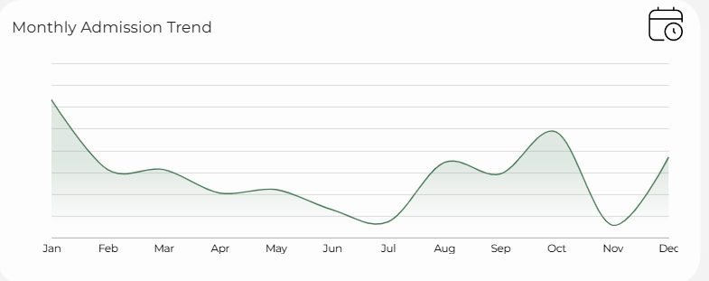
How Does Application Trend Over the Months?
Monthly admission decisions range from 214 to 358, with January showing the highest activity.
The process is relatively distributed across the year rather than concentrated in specific periods. Currently, 1,744 applications (34.9%) remain pending decision.

Slide 16
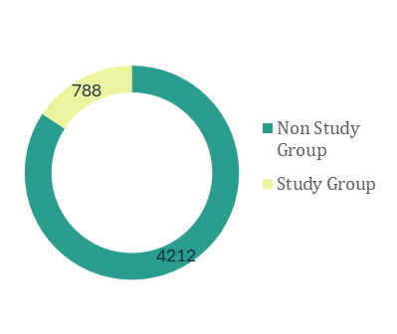
How Do Students Find Us?
Non-Study Group channels (direct website, fairs, independent agents) contribute 4,212 applications (84.2%), while the Study Group partnership delivers 788 applications (15.8%).
DePaul's strength lies in direct recruitment, a competitive advantage indicating strong brand recognition and effective digital presence.

Slide 17

What Should We Do Next?

Slide 18
Strategic Recommendations
DIVERSIFY AWAY FROM INDIA DEPENDENCY
One visa policy change could devastate enrollment. Set an intake cap on India while growing West Africa (Ghana and Nigeria) and entering other under explored markets.
FOCUS MARKETING ON WHAT STUDENTS ACTUALLY WANT
Students overwhelmingly want STEM. Put the bulk of the marketing budget behind these high-demand programs. Launch a "DePaul STEM" campaign.

Slide 19
Strategic Recommendations
REALLOCATE STAFF TO MATCH WORKLOAD
Two colleges (Jarvis and Kellstadt) get 81% of applications but may not have relative staffing to handle the workload, creating burnout and delays. Assign most counselors to these two busy colleges.
CLEAR THE APPLICATION BACKLOG
1,744 applications are sitting in limbo (35%), that's 6 months of work piling up. Students are waiting too long for decisions. Set monthly goals, add temporary help during busy January-March period, use software to auto-approve obvious yes/no cases.

Slide 20
Strategic Recommendations
EVALUATE STUDY GROUP PARTNERSHIP ROI
Study Group contributes only 15.8% of volume but cost-effectiveness unknown. Assess conversion rates by channel, renegotiate contract terms or diversify to alternative agencies.
INVEST IN WHAT'S ALREADY WORKING (NON-STUDY)
84% of students apply directly (not through agencies), this is a strength, but that can be maximized. Improve the website, add live chat support, boost digital ads to make it easier for students to apply.

Slide 21

Conclusion
The University must diversify geography, align resources with demand, and eliminate operational bottlenecks to sustain international enrolment growth while reducing concentration risk; failure to act risks significant enrolment volatility.

Slide 22
THANK YOU FOR LISTENING

